Slide 1
Ethics and Reflexivity in Computing
Prof. Bernd Carsten STAHL, University of Nottingham, UK
25.10.2022; Life in Academia, Oldenburg

Slide 2
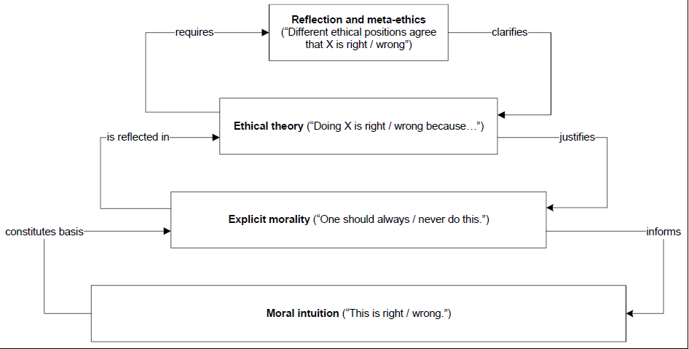
What is ethics?
Stahl, B. C. (2012). Morality, Ethics, and Reflection: A Categorization of Normative IS Research. Journal of the Association for Information Systems, 13(8), 636–656. https://doi.org/10.17705/1jais.00304

Slide 3
Why ethics in IT / IC?T
Speed of innovation and diffusion
Ubiquity and pervasiveness
Applied and fundamental research
Logical malleability
Problem of many hands

Slide 4
Three examples

Slide 5
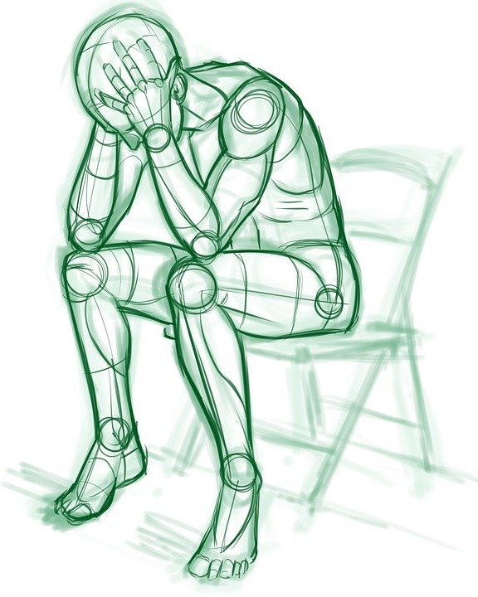
Ethics by Design - Context
The problem: AI causes problems after deployment
The solution: Impose ethical requirements on AI
Ethical AI initiatives are global
IEEE, ISO, IETF, WEF, UNESCO, Governments (EG: Singapore, NYC, California, White House, Australia, Denmark), Industry (FATML, XAI, CertNexus, Google, Microsoft, IBM)
The cause: Insufficient consideration of consequences during design
Our solution: Ethics by design (EbD), i.e. during, throughout

Slide 6
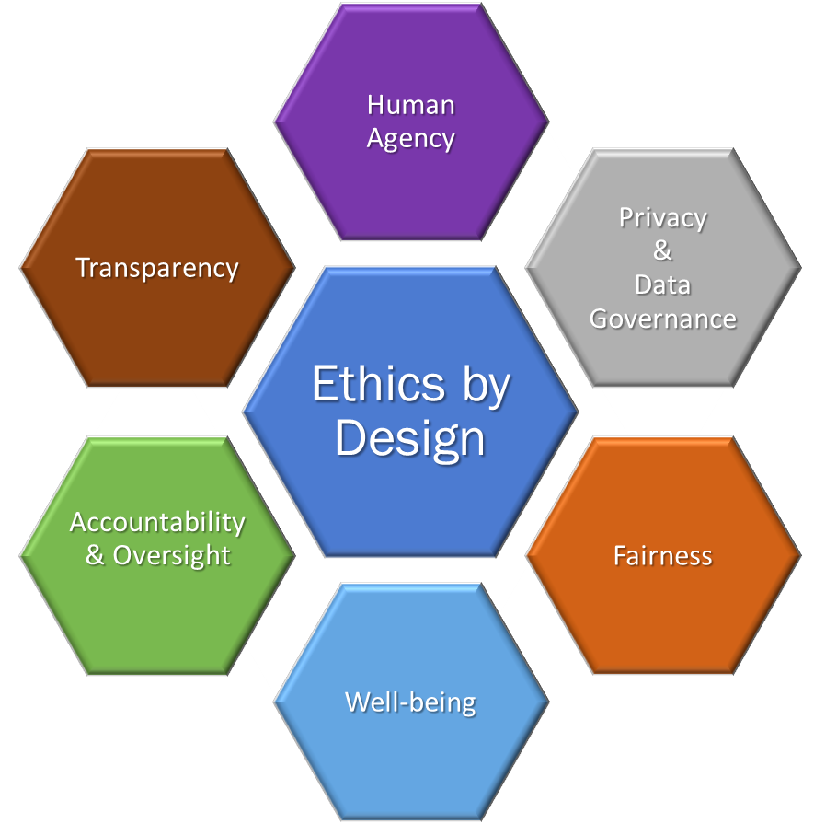
Values
As universal as possible:
EU principles, UN Charter on Human Rights
Unethical AI violates values
Incorporate detailed ethical values
e.g. Human Agency = autonomy, dignity, freedom
Values lead to “ethical requisites”
6 categories of values:

Slide 7
Specification of objectives
Generic Development Model
What is the system for, what will it do?
Specification of requirements
What do we need to build it? Resources, risks, impact analysis, etc.
Requisites mapped onto development as concrete tasks
High-level design
High-level system architecture
Data collection and preparation
Detailed design and development
Actual construction of the system
Testing and evaluation

Slide 8
Towards an Ecosystem of Artificial Intelligence for Human Flourishing

Slide 9
Complex relationships between actors
Unclear boundaries
Characteristics of Ecosystems
Openness
Interdepen- dence of actors
Evolution as driver of change
Co-evolution and mutual learning

Slide 10
Geographical
Delimitation of the ecosystem
Conceptual
Technical
Technical
Conceptual
Requirements for interventions
Knowledge base
Procedural
Capacity building
Adaptive governance
Ecosystems governance
Flexibility
Ability to learn
Meta-responsibility

Slide 11
Delimitation
Governance
considers
mandates
Conceptual clarity
Regulatory framework
EU Agency for AI
AI ethics officer
informs
can include
requires
incentivises
Knowledge
provide
basis
AI impact assessment
includes
Ethics by design
informs
requires
draws on
Training and education
Standardi- sation
Security
Notes:
Use appropriate and clear definitions of AI and digital technology
Develop a regulatory framework and enforcement mechanisms for AI
Establish a European Agency for Artificial Intelligence
Establish Role of AI (Ethics) Officer in Organisations
Develop baseline model for AI Impact Assessments
Promote Ethics by Design for researchers
Create training and education pathways that include ethics and human rights in AI
Include research findings on AI ethics in standardisation
Undertake security analysis for machine learning systems

Slide 12
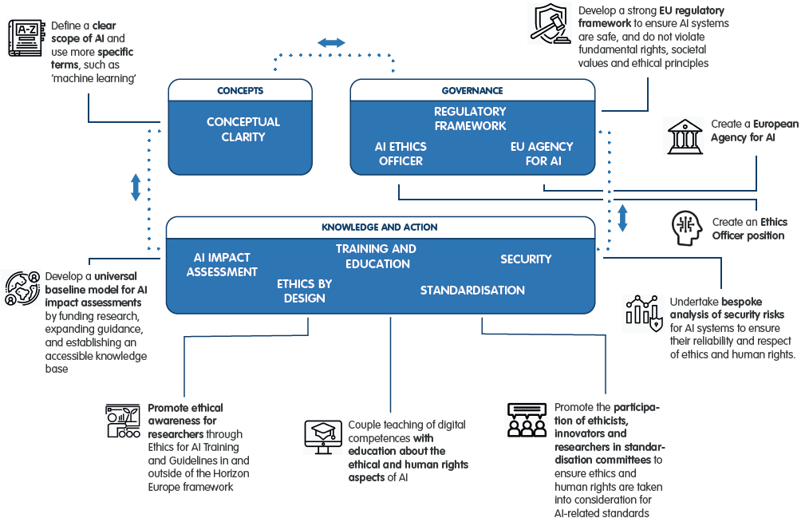
https://www.project-sherpa.eu/recommendations/

Slide 13
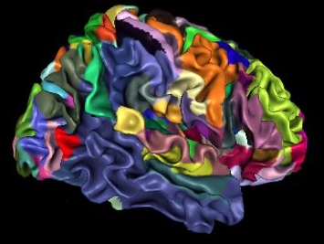
EBRAINS’ mission: Enabling brain research advances and innovation
It builds on the work of the Human Brain Project and
takes it to the next level
EBRAINS offers the science community state-of-the art
Brain data
Simulation and modelling tools
Access to (super) computing resources
Human Brain Project
HBP scientific work
HBP infrastructure: EBRAINS
2023

Slide 14
Ethical and Social Questions in the HBP
Research ethics and compliance
Animal research
Human research
Data-related
Data protection
Responsible data governance
Neuroethics
Consciousness
Dual use, misuse
Diversity and inclusion
Commercial exploitation
Societal consequences
Licence to operate
New (since 2021): AI as an ethical issue

Slide 15
Responsible Research and Innovation in the HBP
Anticipate
Reflect
Public Engagement (PE), Gender Equality, Science education, Open science, Ethics, Governance
Science with and for society
Engage
Act

Slide 16
RRI Activities
Research on various RRI topics
Neuroethics and philosophical reflection
Foresight
Public engagement
Researcher awareness
Ethics support
Capacity development

Slide 17
RRI Structures
Ethics Advisory Board (external experts)
Ombudsperson
Ethics Rapporteur Programme
Annual update (1-pager)
Compliance management workflow
Data Governance Working Group
Dual Use Working Group
Diversity and Equal Opportunities Committee
Representation in project governance
Ethics Director
RRI WP lead in Science and Infrastructure Board

Slide 18
Lessons Learned (2013-2020)
Extensive Public Engagement Can Inform Project Decisions
In Practice Compliance Issues Tend to Dominate the RRI Agenda
Interdisciplinary Collaboration is Challenging when Implementing RRI
Interpretations of RRI Continue to be Subject of Debate
Implementing RRI Reveals Gaps in Knowledge of Substantive Issues
Success of RRI Implementation is Difficult to Prove

Slide 19
Some further insights
RRI remains a contested concept
Expectation management is important
Uncertainty and conflict remain
RRI is not a solution, but a process
RRI needs to co-evolve with the science

Slide 20
Future Plans (2022-2023): Responsibility by Design
Preparation for the transition from research project to distributed research infrastructure
Organisational Integration of RRI
Ethics and Society Vision
EBRAINS Ethics and Society Committee
Community and Capacity Building
From Research to Innovation and Commercial Exploitation
Global RRI Engagement and ensuring societal benefit

Slide 21
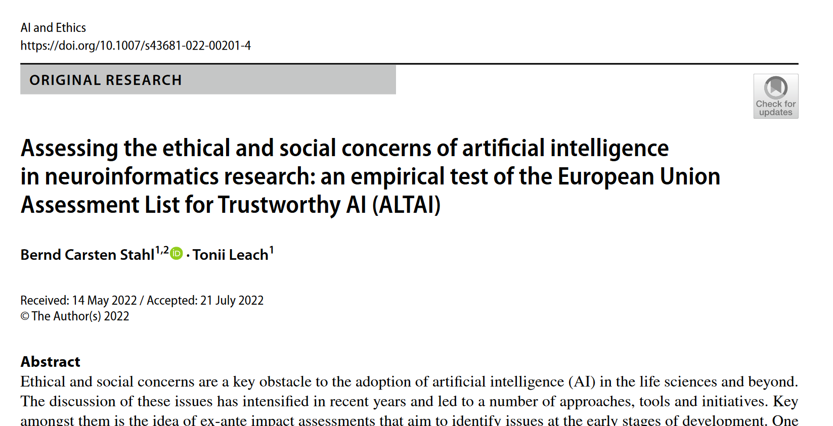

Slide 22
Resources
Responsibility by Design paper in JRI https://doi.org/10.1080/23299460.2021.1955613
HBP website https://www.humanbrainproject.eu/en/social-ethical-reflective/
HBP education https://www.humanbrainproject.eu/en/education/participatecollaborate/curriculum/online-course/research-ethics-societal-impact/
EBRAINS data governance https://ebrains.eu/terms
Ethics Dialogues http://www.ethicsdialogues.eu/
EBRAINS Ethics and Society Vision https://ebrains.eu/ethics-and-society-vision/

Slide 23
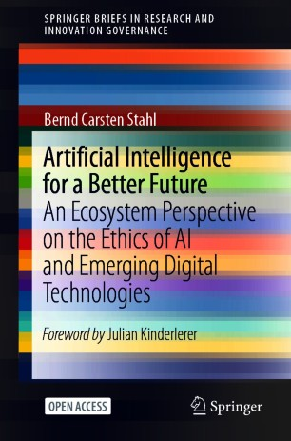
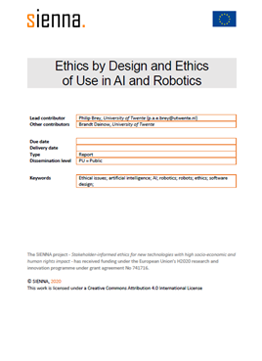
Open Access
https://link.springer.com/book/10.1007%2F978-3-030-69978-9
https://sienna-project.eu/digitalAssets/915/c_915554-l_1-k_sienna-ethics-by-design-and-ethics-of-use.pdf

