Slide 1
School of Computing Science
A few thoughts on
work-life balance
3 May 2022
Wim Vanderbauwhede

Slide 2
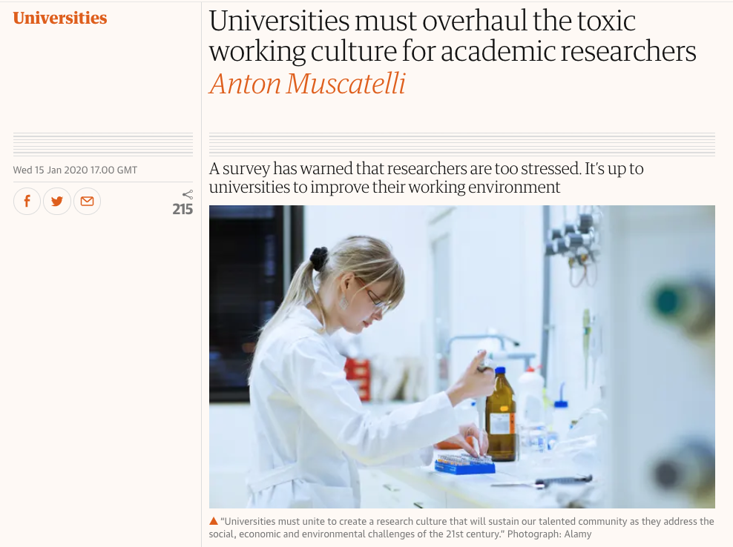
Screenshot from The Guardian web site, taken 20 Jan 2020

Slide 3
Data from the survey “What researchers think about the culture they work in”,
Wellcome Trust, Jan 2020

Slide 4
Data from the survey “What researchers think about the culture they work in”,
Wellcome Trust, Jan 2020

Slide 5
Work/Life

Slide 6
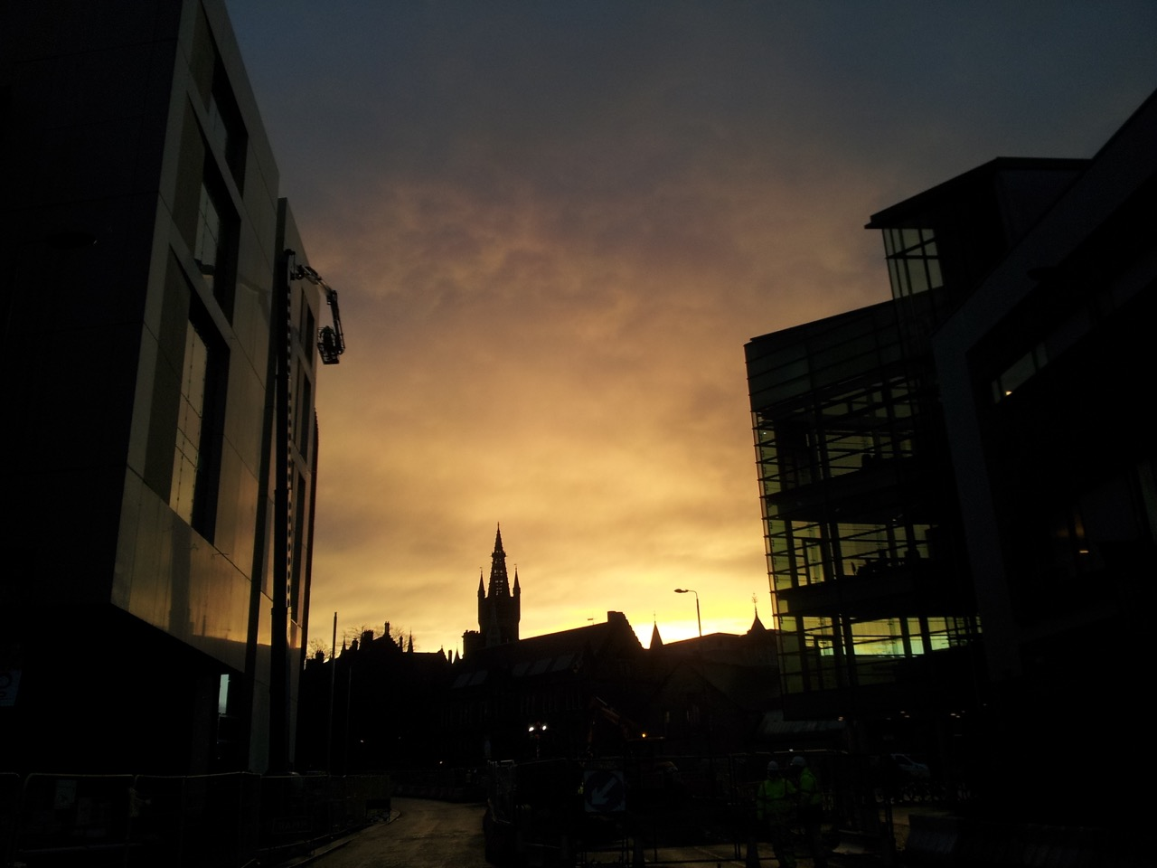
Work

Slide 7
Contracts &
Expectations

Slide 8
Contract
a legal document
sets out rights and duties (e.g. hours, leave)
there are penalties if you break the conditions
an agreement with expectations on both sides
matters a lot more than the legal side
not observing the expectation hurts both sides

Slide 9
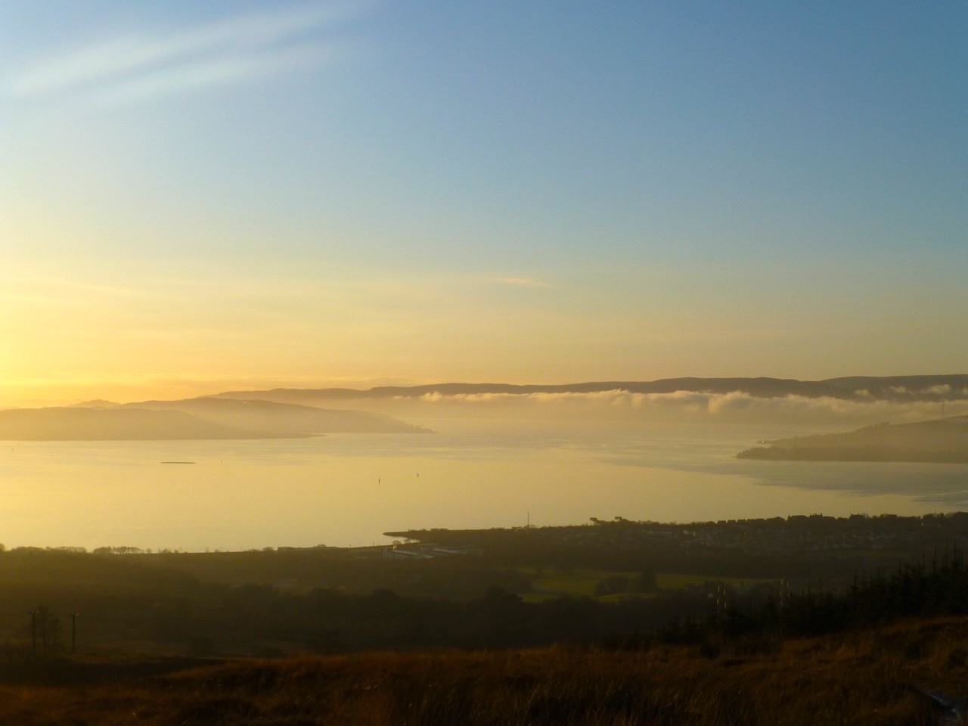
Life

Slide 10
The biology
of happiness

Slide 11
Brain chemicals
Neurotransmitters affecting happiness
dopamine makes you do things: short-term reward, highly addictive
serotonin is related to pride, feeling important, joint achievement
oxytocin relates to trust, kindness
Stress hormone: cortisol
inhibits oxytocin
is bad for your body, physically as well as mentally

Slide 12
The psychology
of happiness

Slide 13
Happiness from without
“Doing/achieving/eating X will make me happy”
Reward from external sources: the dopamine hit
It works but only briefly, not long term
Can be compulsive
Watch out for the patterns

Slide 14
Goals, ambition
and success

Slide 15
Goals, ambition, success
Goals and ambition are positive.
But you need to ask yourself why:
Why do I pursue this particular goal/ambition?
What does success mean to me?
And what will it bring me?
If you don’t define success, then success will not make you happy

Slide 16
Respect

Slide 17
Respect
Everybody wants to be respected
But the people who know you and like you already respect you.
Why does the respect of strangers matter to you?
It’s an imposed model of success: social hierarchy
Careful, it’s a trap!
“Those who matter don’t mind and
those who mind don’t matter”

Slide 18
Peace of mind

Slide 19
Happiness from within
It’s your reaction to a situation that determines your state of mind
Self-awareness, mindfulness
Calm and fulfillment: serotonin
Practicing kindness: oxytocin (social reward)

Slide 20
Pressure

Slide 21
Pressure
You feel under pressure to work long hours
Why is that?
Remember the contract!

Slide 22
What are your reasons?
Any of these?
peer pressure
working against your rhythm
difficulty focusing
too many distractions
everything is a priority
feeling pressurised
daunting goals
few other interests
feeling overwhelmed
hard to say no
perceived expectations
thinking that you’re not efficient enough
everything seems urgent
perfectionism
habit
Or others? Put them in the chat!

Slide 23
Discuss your reasons with your neighbour
peer pressure
working against your rhythm
difficulty focusing
too many distractions
everything is a priority
feeling pressurised
daunting goals
few other interests
feeling overwhelmed
hard to say no
perceived expectations
thinking that you’re not efficient enough
everything seems urgent
perfectionism
habit
Or others?

Slide 24
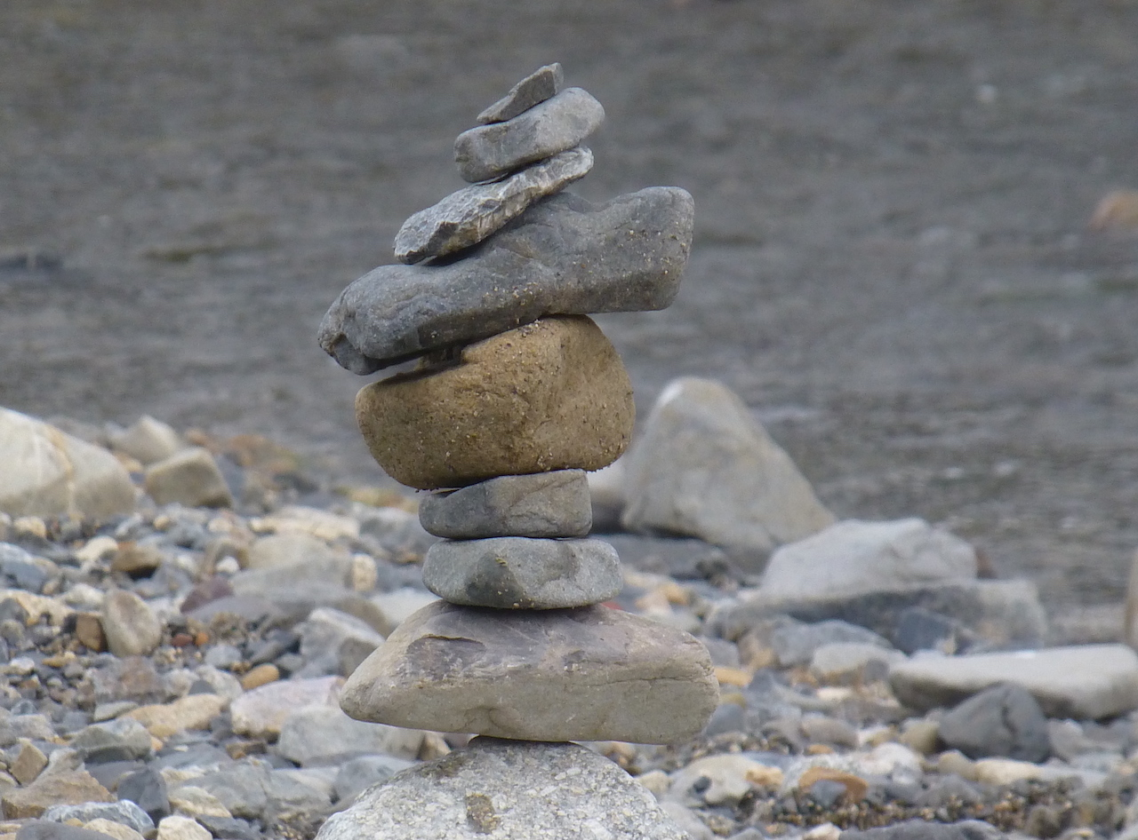
Balance

Slide 25
Benefits

Slide 26
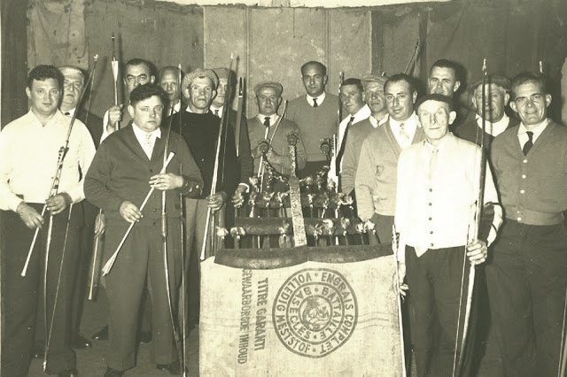
“de boog kan niet altijd gespannen staan”

Slide 27
Resilience
Resilience is a key characteristic for academics
To be resilient you need to recharge
To recharge you need downtime

Slide 28
Productivity
Working long hours is not productive
Long hours destroy concentration
Need for unconscious processing time, essential for problem solving and creativity

Slide 29
Adding value
to your own life: personal development
to other people’s lives

Slide 30
Mental health
Working all the time is dangerous:
If you live for your work and your work goes badly, it is very hard to keep your peace of mind.
Risk of burnout
Karōshi

Slide 31
From the yearly campaign by the Japanese Ministry of Health, Labour and Welfare

Slide 32
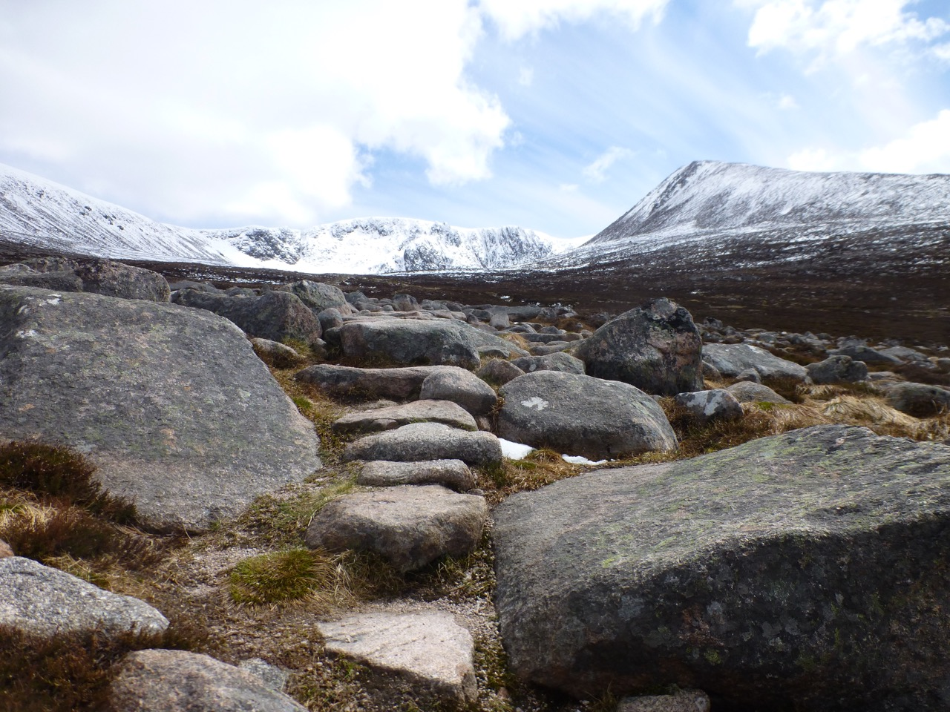
Practice

Slide 33
Mental pressure
Stress level
time

Slide 34
Asking for help
Help with a task or help with your situation
Helps you
Makes the person asked feel good! (oxytocin!)
Provides opportunity for development

Slide 35
Planning
Medium term (semester)
Short term (week)
E.g. ”7 habits of highly effective people”

Slide 36
Taking stock
How’s my life going?
How’s my work going?
E.g. ”Wheel of life” tool

Slide 37
Action plan

Slide 38
Individual Action Plan
I will:
Start doing…
Stop…
Continue to…

Slide 39
Thank you!

Slide 40
Resources
Anton Muscatelli’s article “Universities must overhaul the toxic working culture for academic researchers”
Wellcome Trust survey “What researchers think about the culture they work in”
Simon Sinek’s talk “Why leaders eat last”, about dopamine/serotonin/oxytocin/cortisol
Franklin Covey’s “The 7 habits of effective people”
The “Wheel of life” tool

