Slide 1
Demographic Change and the National Parks of England
Dr. Nicola Thompson
Lecturer
Centre for Rural Economy, School of Agriculture, Food and Rural Development
Newcastle University
Notes:
Nikki – please add CRE logo

Slide 2
Today
Basics on England and Wales National Parks
Why demography is important in shaping the present and future of the Parks
What the Office for National Statistics (ONS) 2011 census data tells us about key trends in the Parks
More questions than answers?

Slide 3
National Parks in England and Wales
1949 National Parks and Access to the Countryside Act
13 parks, 10.8% of land area, 0.7% of the population (402,900)
purposes:
To conserve and enhance the natural beauty, wildlife and cultural heritage; and
To promote opportunities for the understanding and enjoyment of the special qualities by the public.
National Park Authorities have an additional statutory duty
In pursuing the purposes, the Authority should seek to foster the economic and social well being of local communities within the National Park.

Slide 4
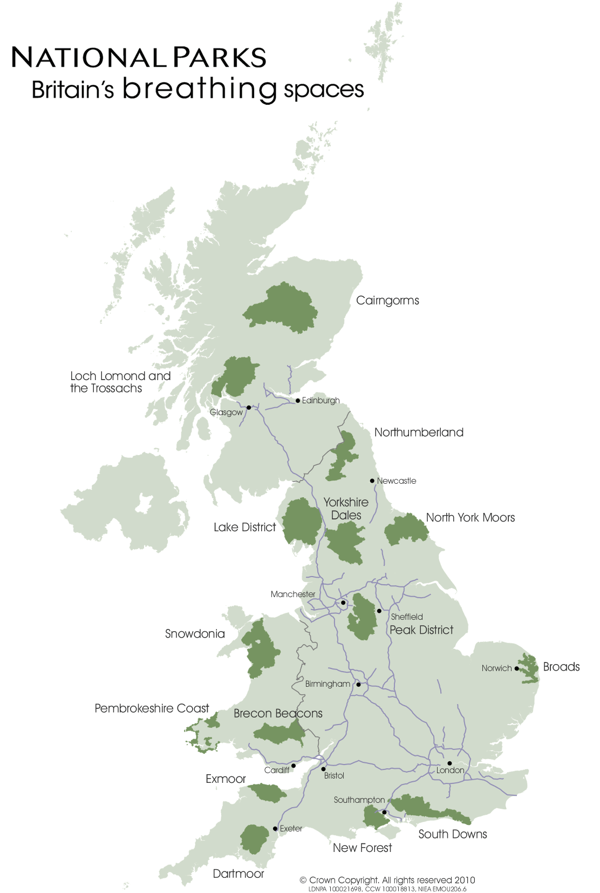

Slide 5
Demographic change?
‘cultural landscapes’ concept
Debates around founding legislation demonstrate consensus around notion that communities should be maintained and supported. Dower and Hobhouse saw no conflict between farming and conservation
Managing authorities given few powers to intervene in social/economic matters. Resident populations seen as custodians.

Slide 6
Today - the language of park management plans
“working community”
“generations of human activity”
“relationship between working communities and the national park”
“Thriving and vibrant communities are vital to the sustainability of the national park and a central theme of the National Park Management Plan” (Peak District NPA www)

Slide 7
World Heritage Site bid - Lake District
Cultural landscape category
http://www.lakedistrict.gov.uk/caringfor/projects/whs/why-the-lake-district

Slide 8
Critics of national parks point to…
Effect of designation on the economic sustainability of farming and other land management activities
Affordable housing – no homes for locals (or teachers, nurses, health and social care workers)
The preservation of a particular landscape aesthetic rather than evolving, living landscape

Slide 9
The role of communities….
But while debate continues on…
The impact of different land management activities
The appropriate policy response (especially relating to planning)
Whether the socio-economic duty should be a purpose
There remains a high degree of consensus that national parks in England and Wales are living, working landscapes, not just breathing places!

Slide 10
Literature
Extensive on economic and social trends in farming communities. Often use NP case studies
More fragmentary on the rest of the NP population
Census data enables analysis of ‘national park trends’ but vitally the differences between them.

Slide 11
ONS characteristics of NPs, 2011
NP population risen by 1.9% 2001 – 2011 (national increase 7.1%)
NPs have a much older age structure that rest of the population – one third aged over 60
1 in 8 household spaces has no usual resident
One in four economically active Park resident is self-employed (double national level) while unemployment is much lower

Slide 12
Important variations in population change
Very wide variations in population numbers and densities
4 parks % decrease – Exmoor, Lakes and North York Moors. Tiny decrease in Peak District
Biggest gainers (6% +) South Downs and The Broads
Question – relation to wider demographic shifts or policy approaches?

Slide 13
ageing
Smaller proportions in all U45 age groups and greater proportion in all over 45 age groups than for England and Wales
Some variation in the pattern for 0 – 14 age group
All parks had a decrease in 30 - 44 age group between 2001 and 2011 and all had increases in the 60+ groups.
Median age 50, 11 years higher than national average

Slide 14
‘no usual resident’
14% of all household spaces had no usual resident compared with 4% nationally
Over 20% in Pembrokeshire, Lakes, Snowdonia and Yorkshire Dales
Less than 10% in Brecon Beacons, Dartmoor, New Forest and South Downs

Slide 15
employment
Working population defined by ONS in this case as those aged 16 – 74. increased from 665 in 2001 to 69% in 2011
19% self employed (compared to 10 % nationally)
Exmoor 39% of the economically active population self-employed
Only 5.4% of NP residents who are working are employed in agriculture (less than 1% nationally)
Much higher proportions in NPs classes as skilled trades and managers, directors and senior officials

Slide 16
More questions than answers?
Census provides some interesting statistical data that is specific to the national parks
Data should challenge those involved in NP management to decide what, or if, a response is necessary
Still a series of why questions that can’t be answered by census data alone
Need to understand the positive and negative implications of certain trends as have for ‘no usual resident’ for at least 30 years
Ageing
Self-employment

Slide 17
Conclusions
Socio-economic well being beyond affordable housing ?
Interactions between the noted trends and patterns clearly important
Implications for NP management planning?
Implications for public, private and voluntary sectors beyond the traditional conservation/recreation orientated agencies?

