Slide 1
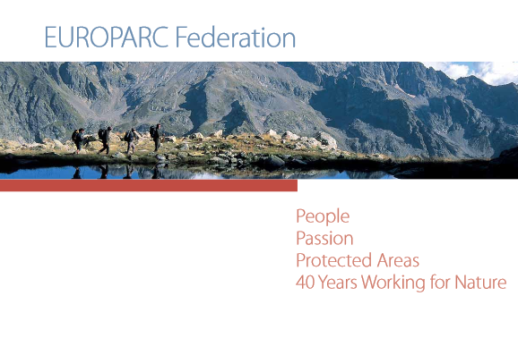
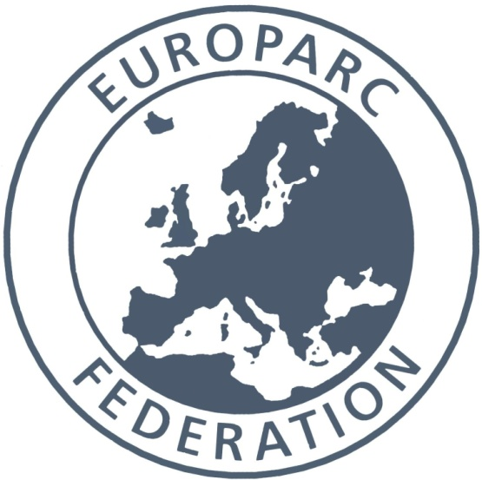

Slide 2
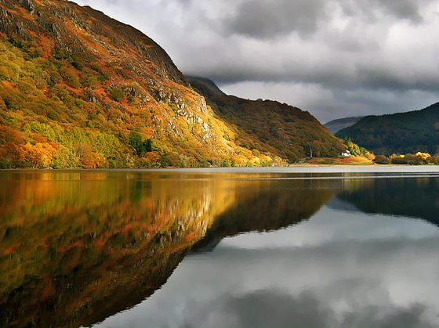
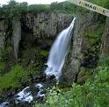

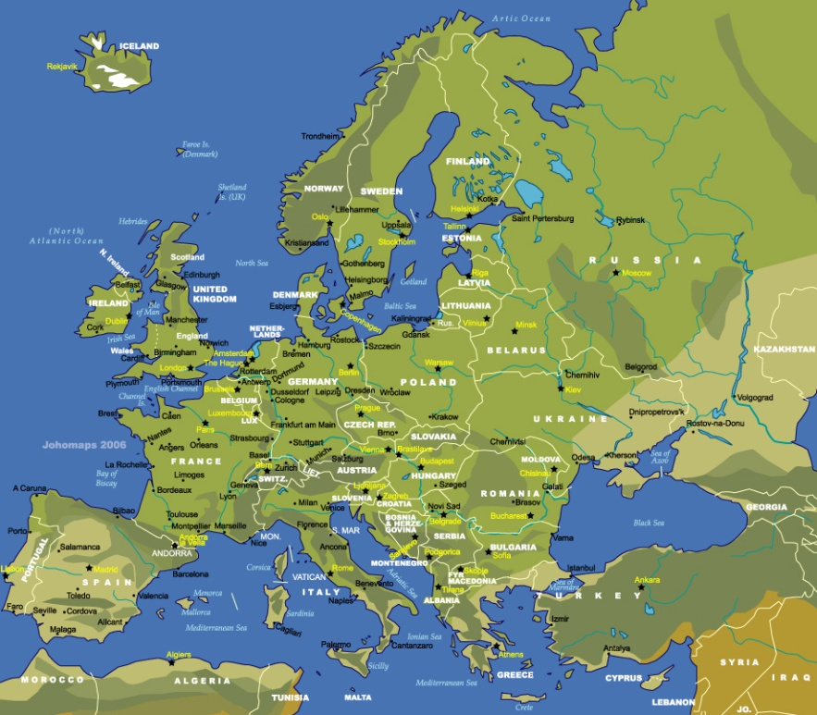



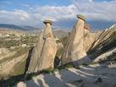


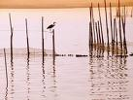
Snowdonia Wales
Skaftafell Iceland
Jostedalsbreen Norway
Variety of landscapes, embedded in cultural identity. Often sculpted by nature and shaped by people.
Influenced course of history, inspired artists and thinkers and enriched lives. They are our natural life support system.
These protected areas represent the land that is our inheritance , - we hold it in trust for those who come after us.
Kemeri , Latvia
Ferto hansag Hungary
Cevennes, France
Goreme Turkey
La Albufera Spain
Triglav Slovenia
Piatra Ciaiului Romania

Slide 3
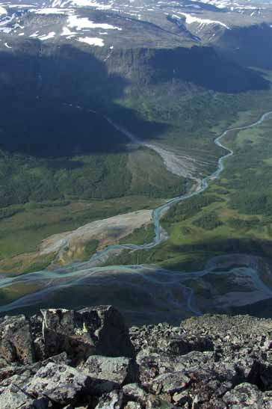
Europe’s Protected Areas
By numbers
About 68,200 protected areas in Europe (EU27)
National/Regional designated Protected Areas covering almost 19% of EU = Italy + Spain surface
About 7,7% of N2000 sites are within National/Regional designated PA
Protected Areas affect almost ¼ of the EU population
Last 10 years Protected Areas in Europe have grown 23% but average dimension decreased
Protected areas were once planned AGAINST people, now it is recognised that they need to be planned WITH local people
Notes:
We represent protected areas across Europe. National Parks , biosphere reserves and off course natural regional parks too!!
So what are the Protected areas of Europe in NUMBERS…. IN reality….They are your friends and colleagues in the EUROPARC network across Europe.
Across all of Europe there 68200 protected areas, they in total cover the land size of Italy and Spain together (19%) of the land surface of the EU but many are small N2000 sites, but some large parks. … however the biggest majority., lIKE French regional Parks have a human component to them. Parks are about nature and People.

Slide 4
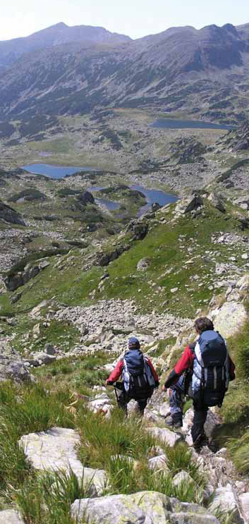
EUROPARC is the leading European organisation for protected areas bringing together dedicated professionals, agencies, academics and decision makers.
Our mission is…..to increase effectiveness in conserving and enhancing natural and cultural heritage, for the well-being and benefit of future generations

Slide 5

Nature knows no boundaries.....so
EUROPARC
is founded on the principle that the future protection and conservation of nature is achieved through
INTERNATIONAL CO-OPERATION.
International cooperation works best through
PERSONAL CONTACT.
That through personal contact comes
MUTUAL UNDERSTANDING, SHARED EXPERIENCES , KNOWLEDGE AND INNOVATION.
This delivers better support and management of protected areas which ensures the
FUTURE PROTECTION AND CONSERVATION OF NATURE . ..
because Nature knows no boundaries.........

Slide 6
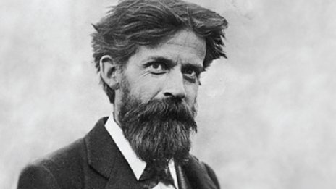
Patrick Geddes,
19th/20thC biologist, sociologist philosopher and town planner...and with crazy hair and beard...
The Region, planning model..... Predicted the role of Protected Areas ?
Microcosmos naturae, sedes hominum, theatrum historiae, eutopia futuris

Slide 7
Microcosmos naturae

Slide 9
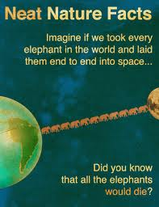
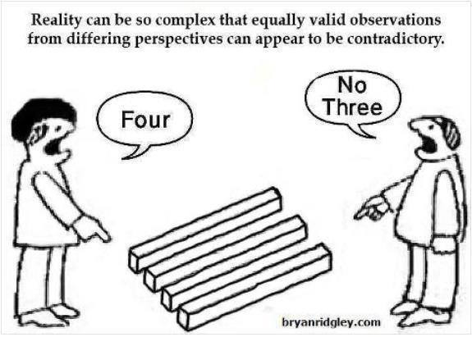
What?
HOW?

Slide 11
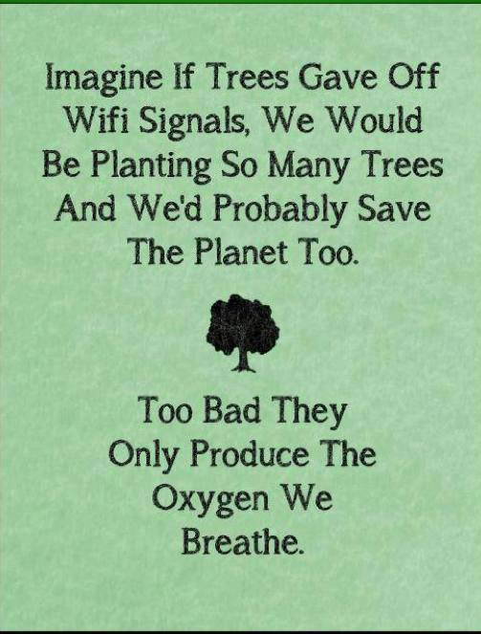

Slide 12
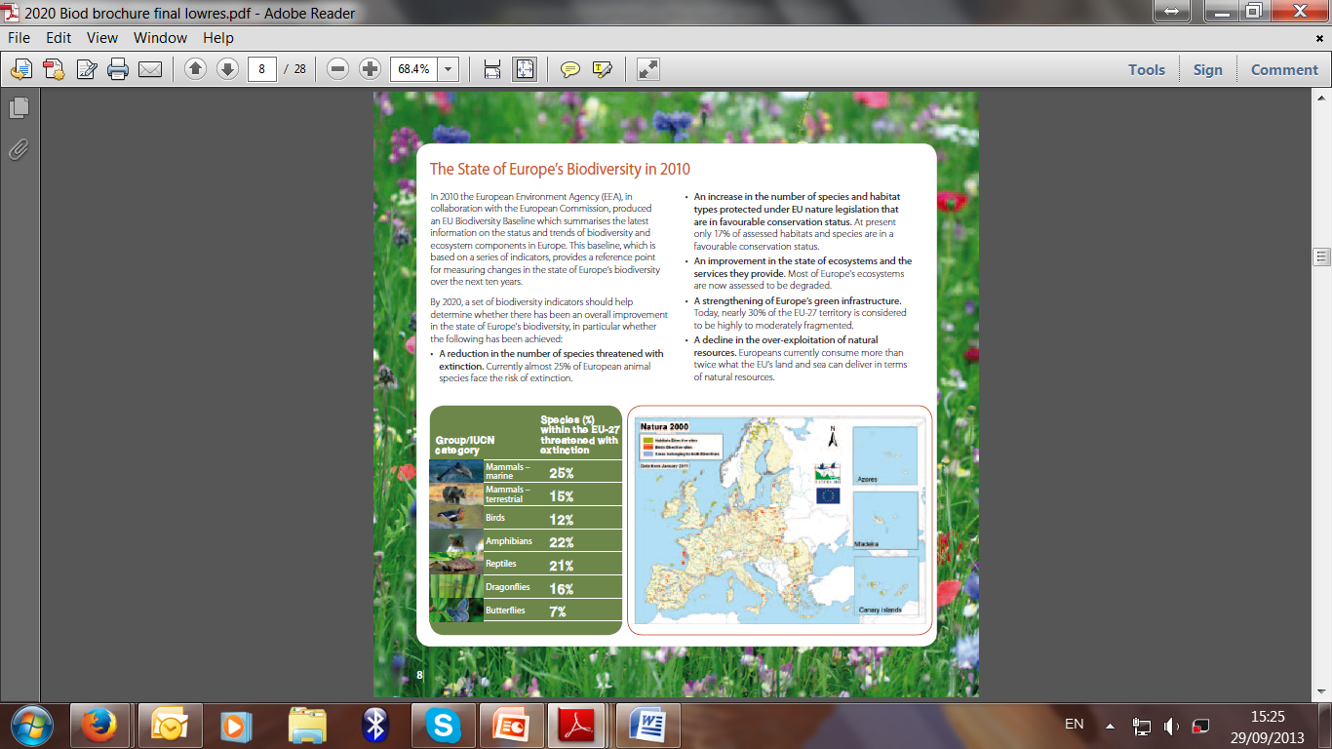
EU Biodiversity Strategy 2020

Slide 13
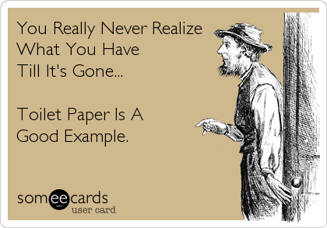

Slide 14
Sedes Hominum

Slide 16
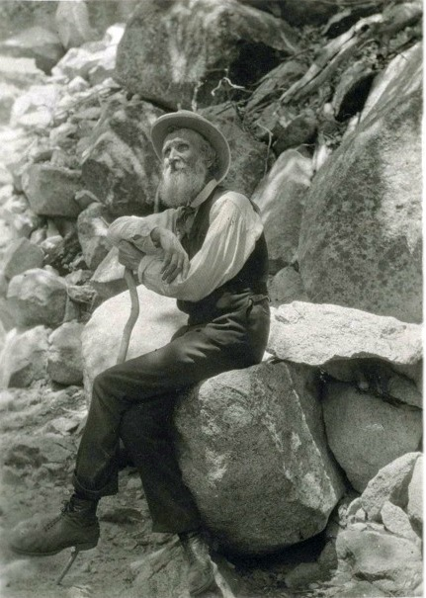
John Muir
"When we try to pick out anything by itself, we find it hitched to everything else in the Universe."

Slide 17
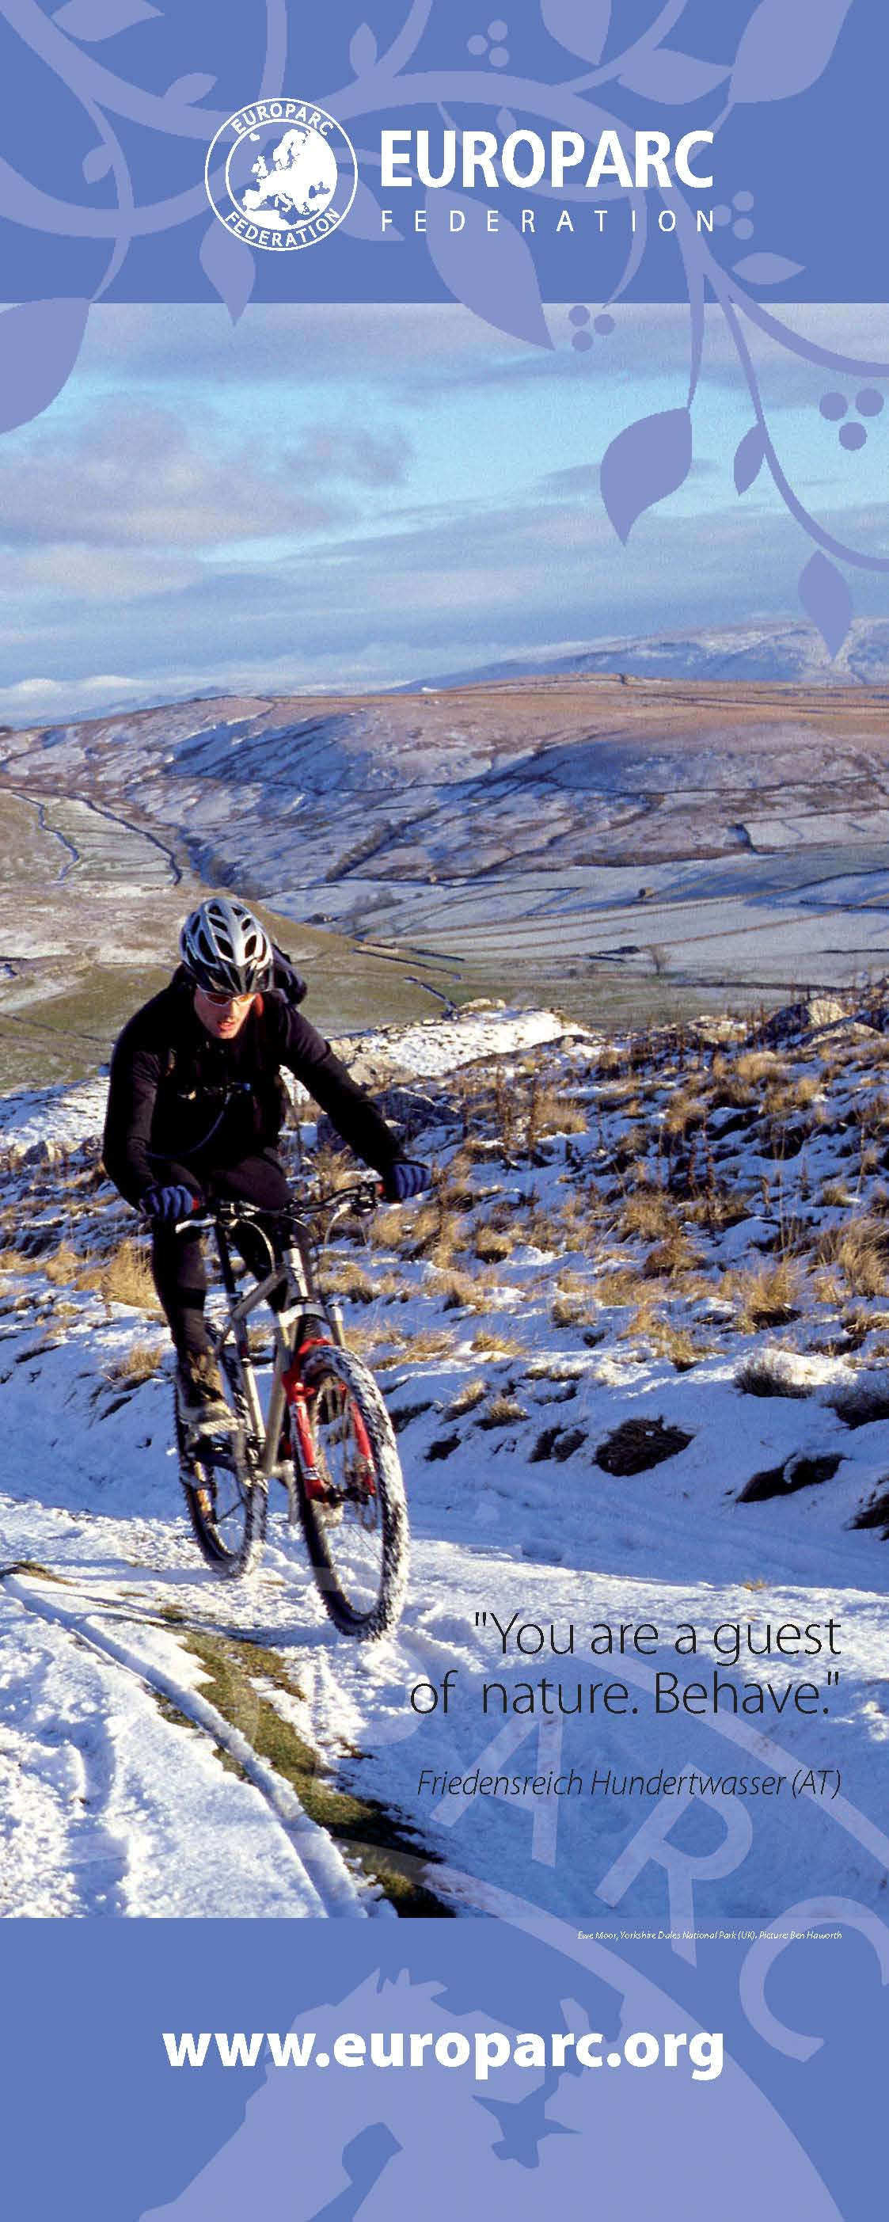

Slide 18
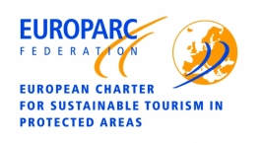
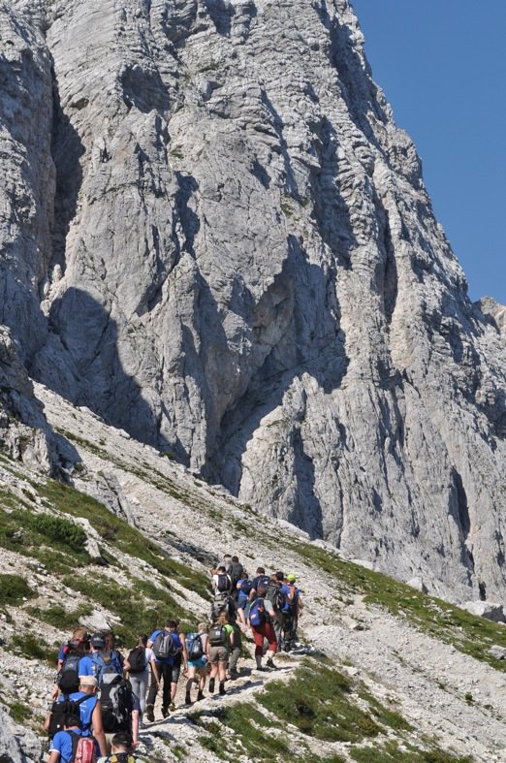
Tourism is relevant for parks and their communities.
An opportunity and a big challenge:
Loving them to death?
In Spain 20M visits to park facilities in 2011
In our charter parks, 441M Euros were invested in sustainable tourism actions (2012)
Notes:
Tourism has become a big topic for protected areas across Europe ..and its has some big numbers..and big money associated with it....
Tourism is a significant industry in Europe with over 40 percent of European travellers surveyed in 2000 included a visit to a national park
ITALY and Spanish NUMBERs READ from SLIDE
As we know tourism keeps an ambivalent character, it can promote the economic and cultural development of a region,
but it can also determine its irreversible deterioration: tourism can destroy itself .
We have to be careful that the do not destroy the very resource we depend on through unsustainable management.

Slide 19
Theatrum Historiae

Slide 20
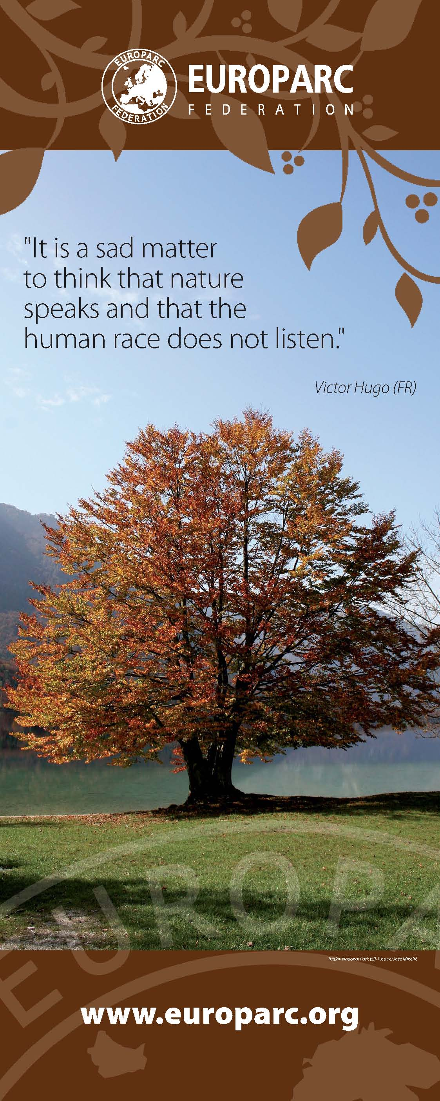

Slide 21
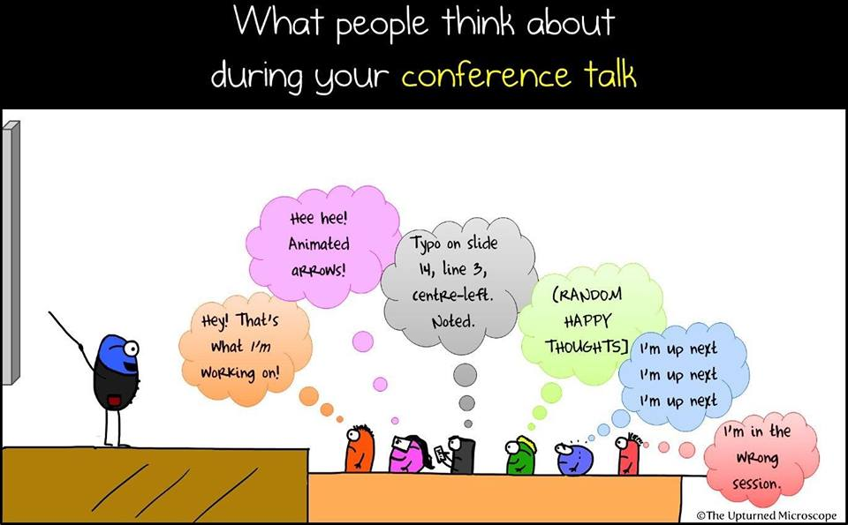

Slide 22
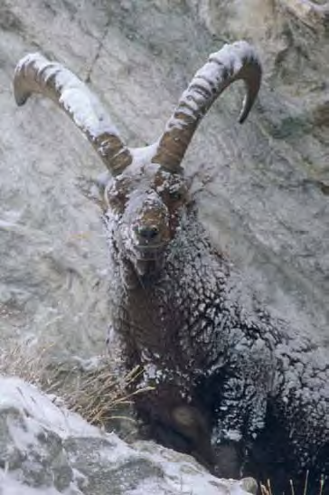
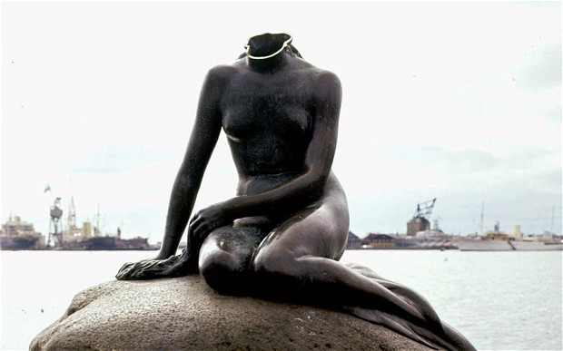
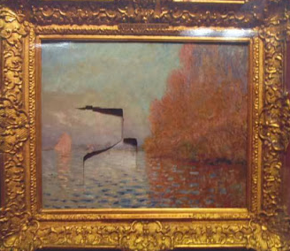
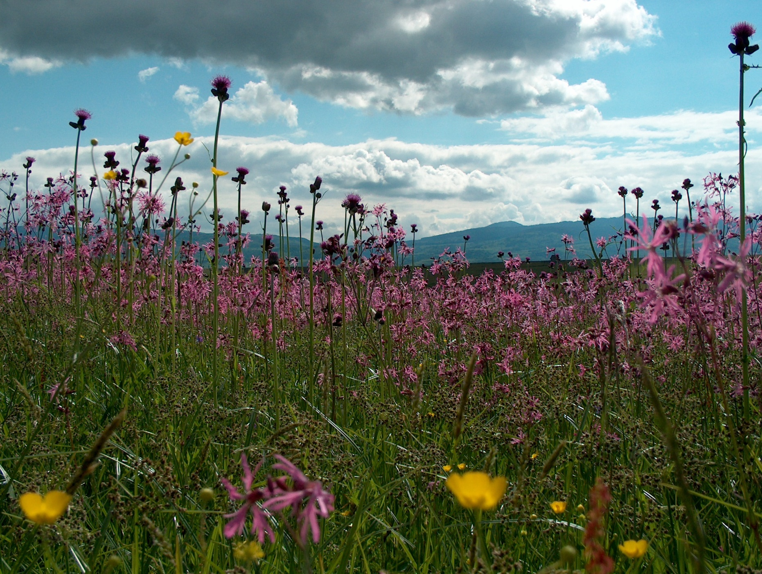
National Treasures or Natural Treasures.....?
.. Europe’s Protected Areas....are we in danger of “neglecting them to Death “..

Slide 24

Partnership

Slide 25

Transboundary Parks – Following Nature’s Design”
9 certified transboundary parks formed by 19 protected areas from 11 countries
Total area of more than 800.000 ha
More than 280.000 ha of Natura 2000 areas within the certified PAs
Around 1000 staff members employed in the certified Pas
Positive effect on endangered species reported in 62% of the surveyed PAs.
Positive effect on sustainable tourism development in 54% of the PAs
Frontier on the map, cooperation in mind

Slide 26
Eutopia Futuris

Slide 27
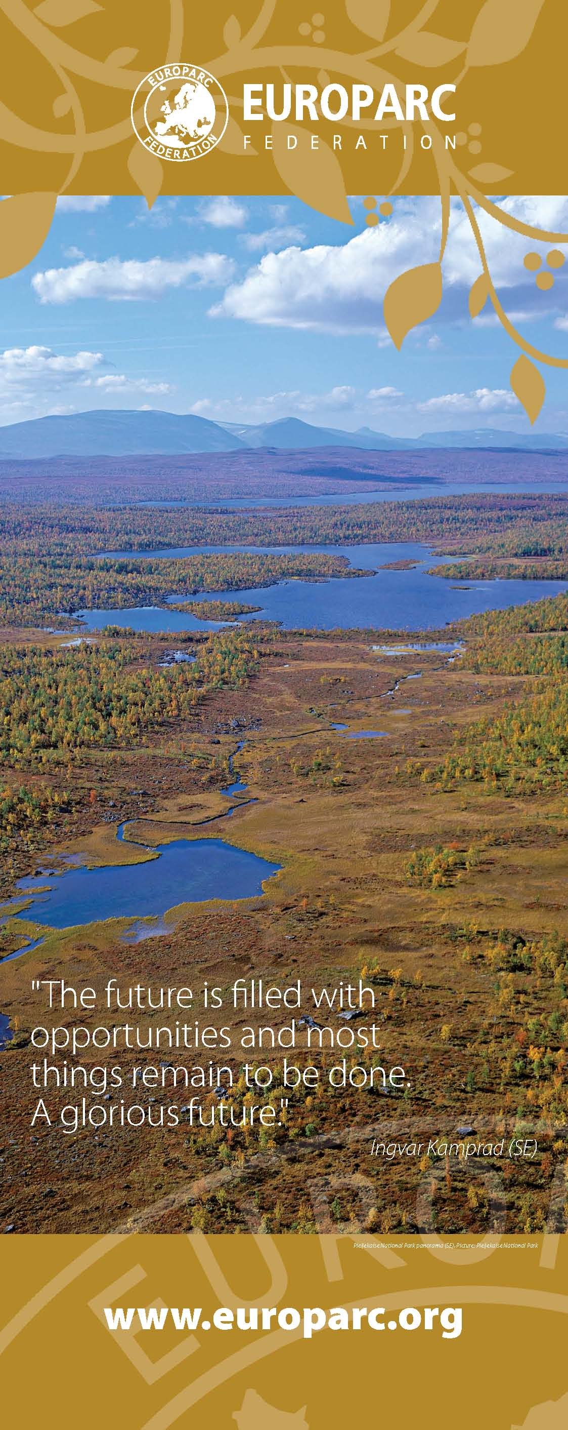

Slide 28
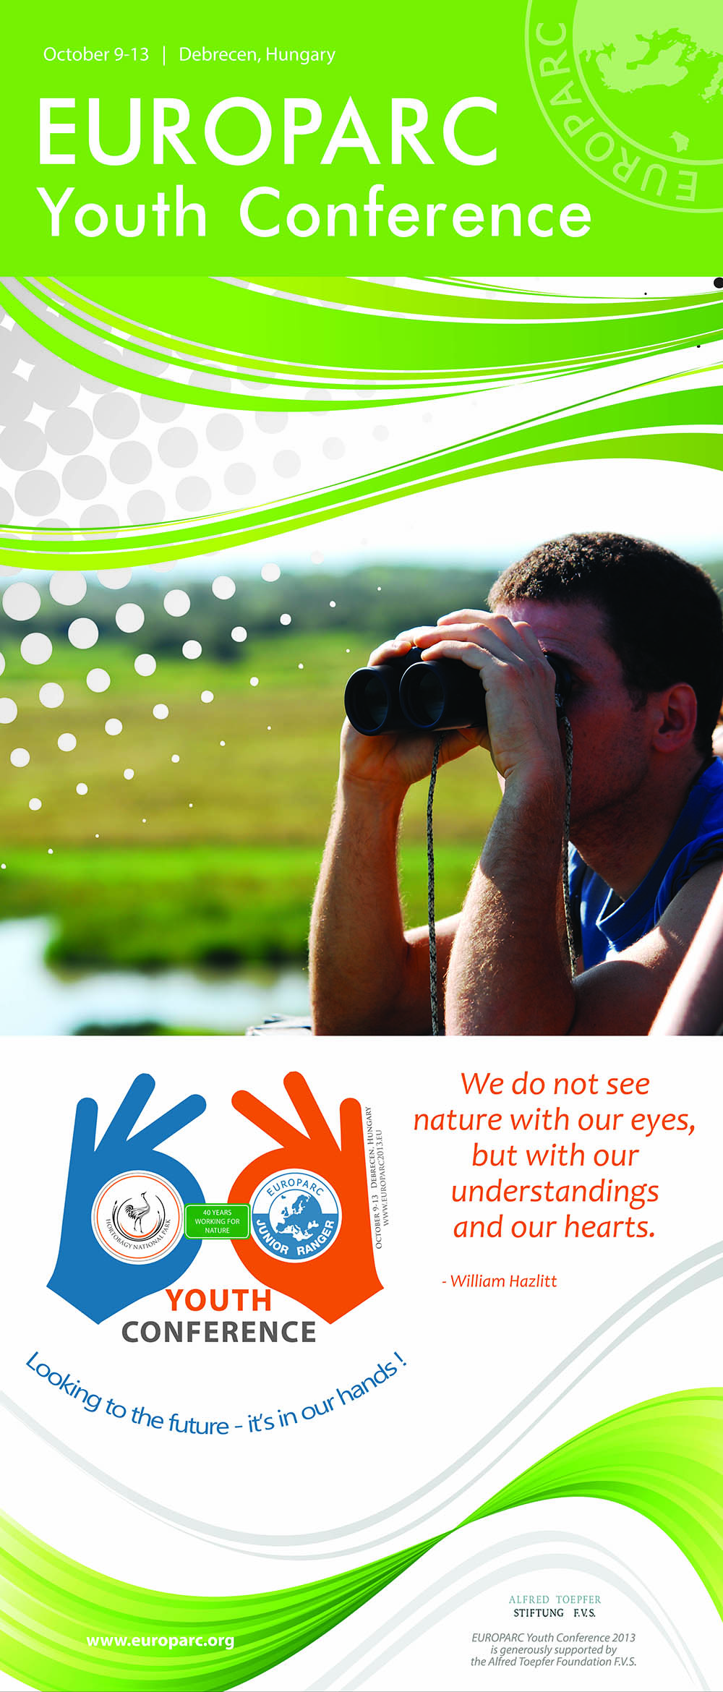
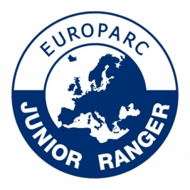
EUROPARC Federation has a long established Junior Ranger programme which involves 32 Protected Areas across 14 different EU countries, and brings together about 5000 youths every year.
Annual International Junior Ranger camp interacts with rangers across many countries who themselves engage with young people.
1st International youth conference 2013.

Slide 29
The (real) challenges for Protected Areas
The --------Tions
Implementation – slow implementation of existing conventions and legislation
Integration – inadequate across all policy areas
Restitution, Compensation – insufficient funding
Education – knowledge gaps, skills gaps, policy gaps
Communication - institutional cultures, feel good factor?
Disconnection – the human disconnect to nature
Certification-management effectiveness
Perception –no societal consensus, relevance?
The Challenges for Protected Areas
Remaining Relevant to multiple Political agendae
Climate change
Biodiversity loss
Development / Land Use Pressures
Governance
Sustainable finance
Communication

Slide 30
Convert Aspirations into Action
Adopt innovative, forward thinking, outward looking inclusive approach– partnership working with communities, business, academia.
Examine the Culture, Remain Relevant
Be the nature reserve, health centre, spiritual retreat, sports facility, ecosystem services “factory”, cultural repository, iconic landscape, national identity. = protected area.
Embrace Sustainability - European protected areas need to be models for nature conservation sustainable natural resource use benefiting society and maintaining Europe’s cultural heritage and traditional rural livelihoods
Continue to engender sense of Protected Area community across , Common Goals: Shared Vision, encourage exchange of ideas, network.
Make it REAL!
Collaborate and continue to build partnerships protected areas – concentrate on what they do, less on what they are… Network –Learn from others! Saves money!
Show me the Money..!! What’s a park worth.
Parks of the Future
Leap of Faith?
Notes:
Investments needed to manage the Natura network , at least € 5.8 billion per year.
Benefits from the network of Natura 2000 sites are of the order of €200 to 300 billion/year.
1.2 to 2.2 billion visitor days to Natura 2000 sites each year providing recreational benefits estimated at between €5 and €9 billion per annum.
Direct and indirect economic impacts estimated in the range of €50-85 billion
Supporting directly and indirectly between 4.5 and 8 million full time equivalent jobs.

Slide 31
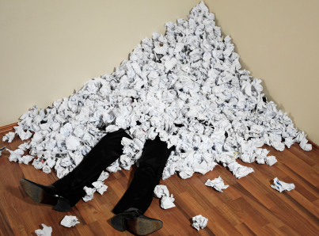
It’s all a bit too much for park managers.........

Slide 32
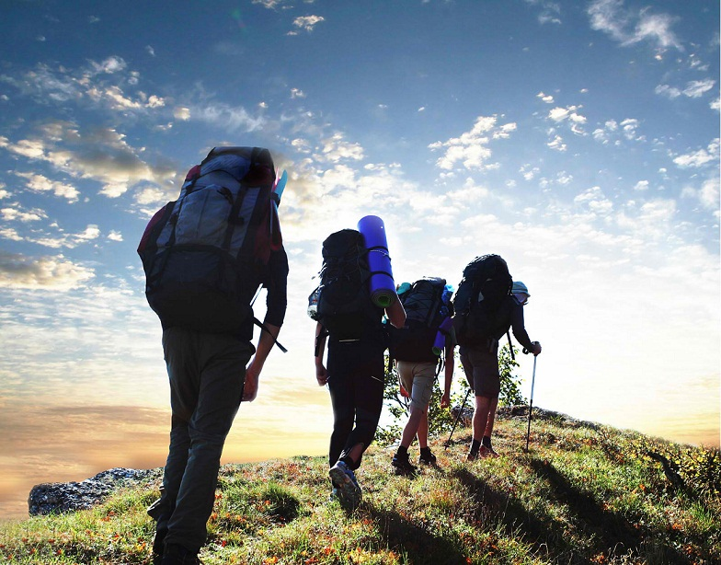
The Key Fundamentals of Protected Area management are
The 4 P’s
Protection of the Natural and Cultural Heritage✓
Participation by ALL Actors✓
Partnership with shared goals and vision✓
Planning....... ✓
.......and......... ??
Notes:
Pounds, political support, ....

Slide 33

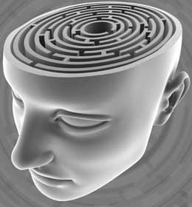
The challenges for Park Management..
A shift in thinking and approach ?
The landscape of the mind?
Is this the real “Inconvenient Truth?”

Slide 34
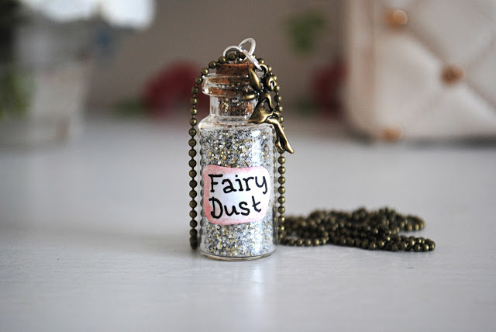
Science
Tools
Effective management.
All the ---Tions.....
Culture
Identity
Politics
Spirituality
Protected Area Management is an Art
...and the fairy dust is.......
Notes:
We need the scientific ‘rational’ approach and the ever evolving battery of scientific methods and tools to help understand what is there, to help ensure that the PA systems make sense ecologically, to ensure that critical natural values are better understood and that the effectiveness of management strategies is monitored.
However although the scientists are very keen to tell us WHAT, they are often remarkably reluctant to tell us HOW. They leave that to the managers (but are enthusiastic about letting us know when we get it wrong!)
NP management should be rooted in the scientific ideal, but must adapt it to take into consideration numerous other factors (social, political, economic, spiritual, cultural etc. etc. ) in order to make Parks work. Park management is an art, not a science; it is not engineering. The best Parks are not purely technocratic entities, they are more than that and they will not be cherished if that is all they are. And if they are not cherished, they are in peril. I would rather have the problem of loving them to death than that of neglecting them to death!
For me, the best Parks are those that have a rational basis, but which take a pragmatic approach and which constantly enquire, listen, adapt and adopt. But most importantly all the best parks include a good amount of ‘fairy dust’ in the whole mix. What is the fairy dust? Well it is different for every park; it can be all sorts of things, depending on the place, its history, who lives there, the users, the people who manage it. You know when you get there!

Slide 35

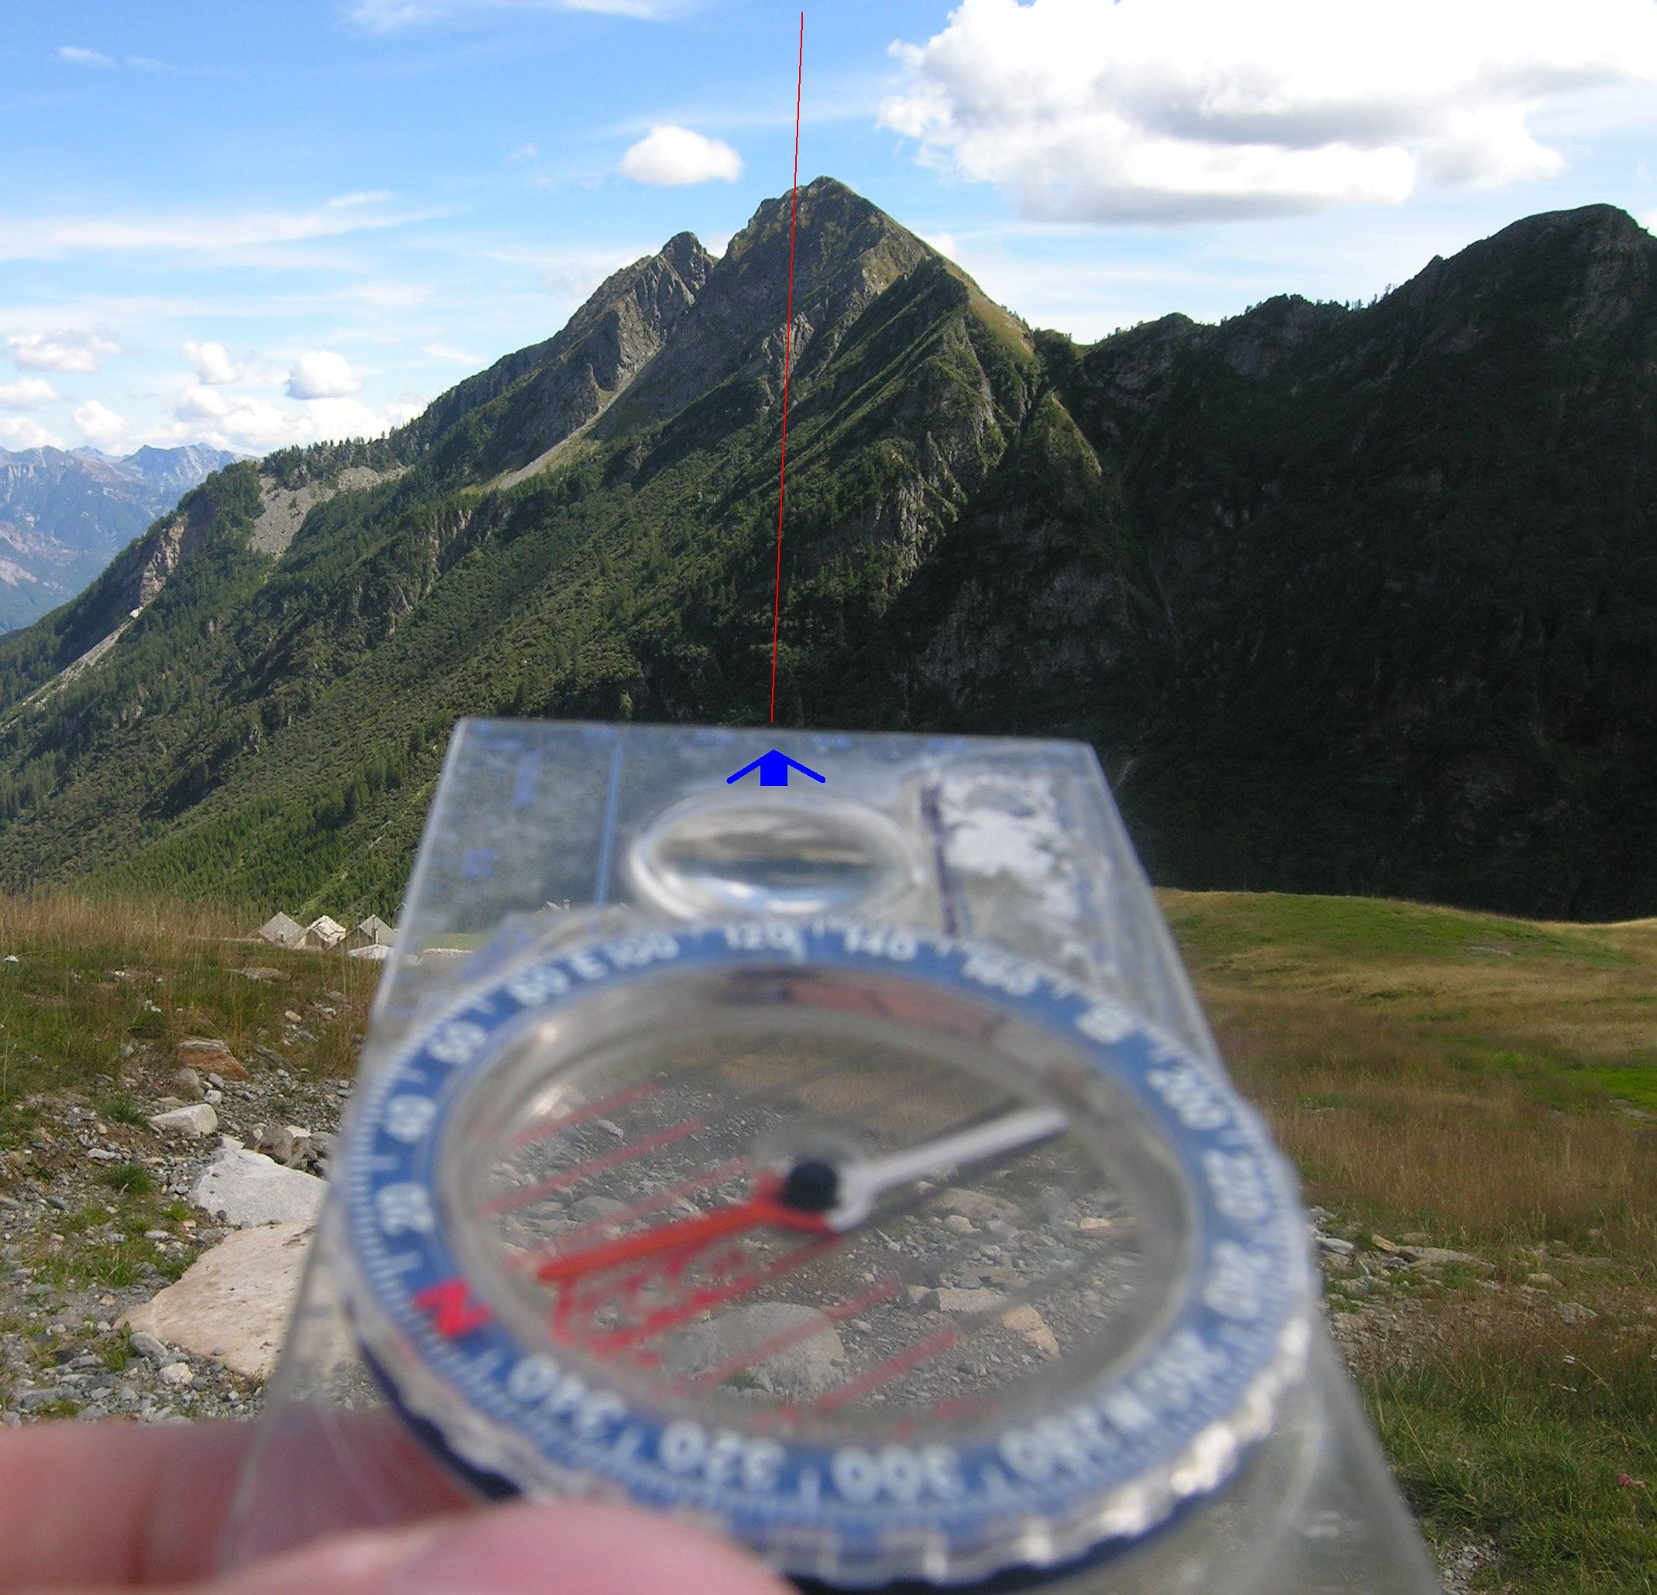
One Degree of Difference

Slide 36
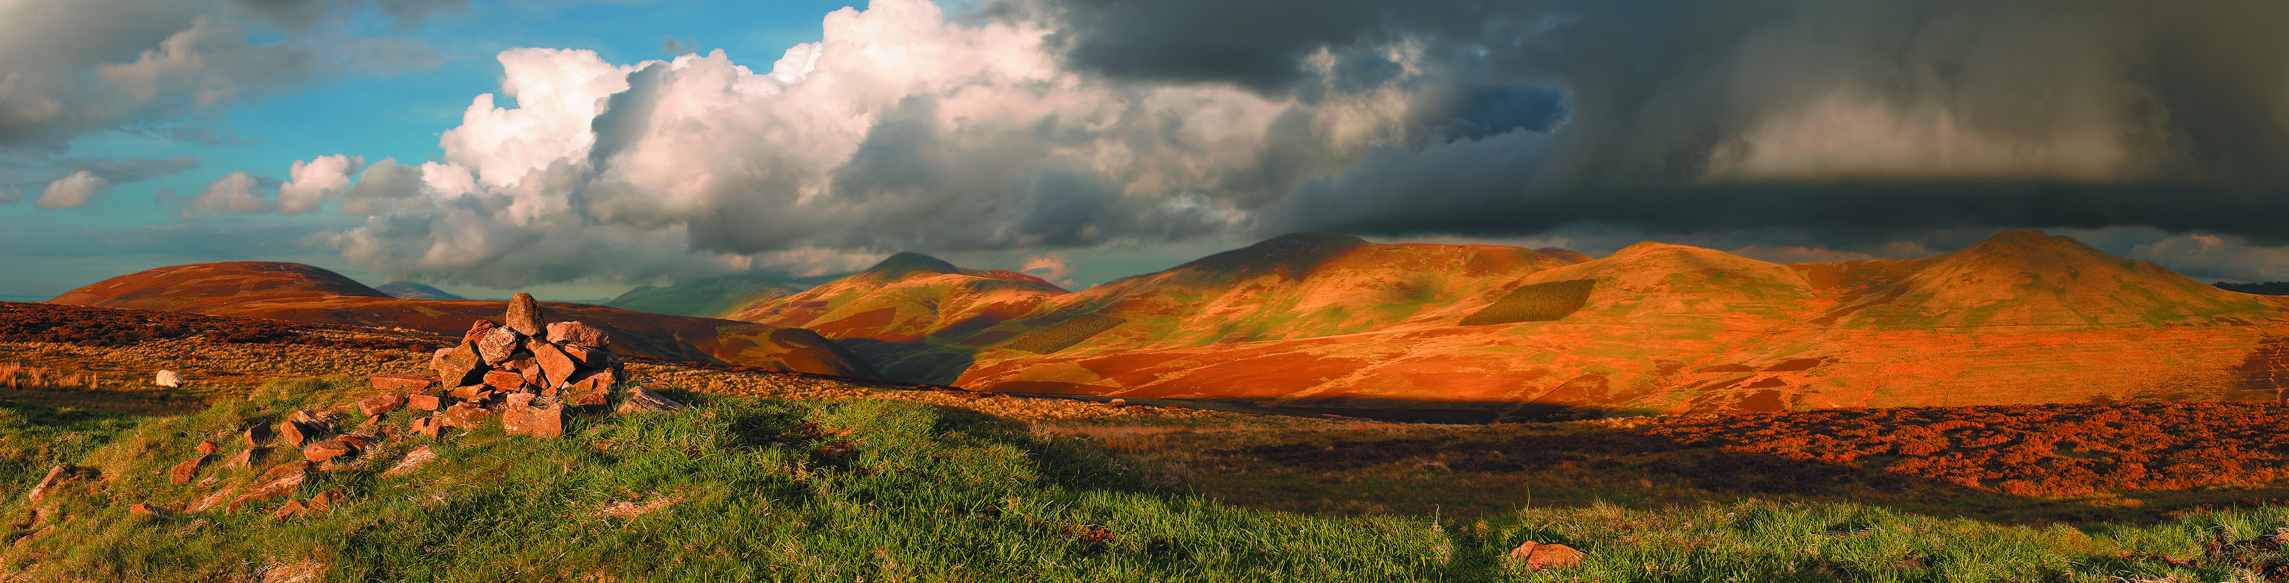
Destination - Parks of the Future
Europe’s Protected Areas are much increased from the early 21st C, by a range of appropriate designations and management agreements. The need for integrated management to ensure a healthy and sufficient life support system is realised and resourced through the decisions of the expanded EU.
Responsible recreational use is appropriately managed, with well-trained staff , co-operating to commonly agreed goals, across national boundaries. Across all Protected Area all levels and interests within local communities are proactively involved in the decision - making processes governing the Protected Area.
Protected Areas are valued further by society, not just intrinsically, but also for the many ecosystem services they deliver. Staying true to their core values they recognise additionally the added value they provide in terms of benefits to society such as protect and conserve biodiversity , deliver opportunities to improve health, contribute to a sustainable society and ensure citizens are informed and educated.
Notes:
Europe’s Protected Areas are much increased from the early 21st C, by a range of appropriate designations and management agreements. The need for integrated management to ensure a healthy and sufficient life support system is realised and resourced through the decisions of the expanded EU.
Responsible recreational use is appropriately managed, with well-trained staff , co-operating to commonly agreed goals, across national boundaries. Across all Protected Area all levels and interests within local communities are proactively involved in the decision - making processes governing the Protected Area.

Slide 37
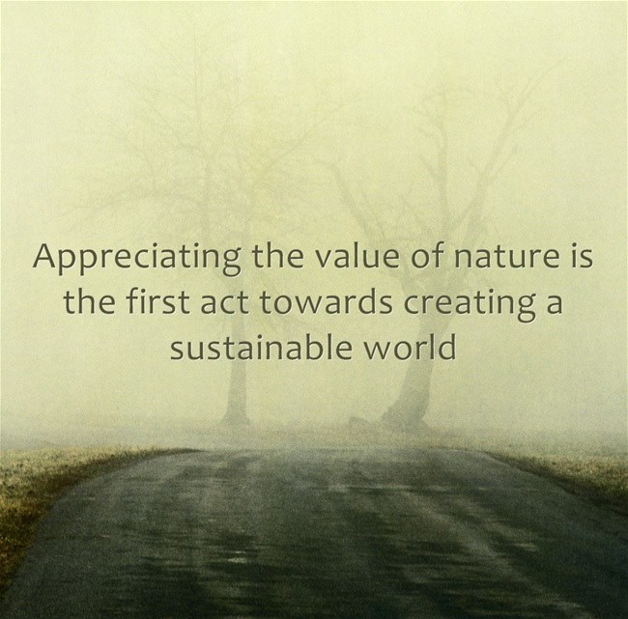

Slide 38
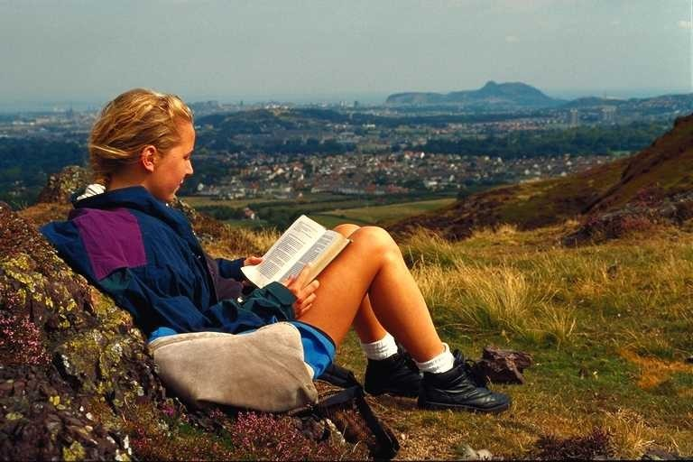
We have a twenty-first century responsibility of great importance. To meet the challenges , promote new creative approaches and thinking and make new partnerships.
It is to proclaim anew the meaning and value of Protected Areas, of biodiversity, conservation, and recreation; to expand the learning opportunities and share that knowledge broadly;
and to encourage People to experience and CONNECT WITH these special Places.

Slide 39
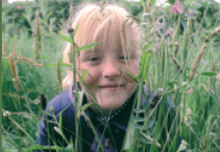
The creation of Protected Areas of Europe and indeed The EUROPARC Federation was an expression of faith in the future, a pact between generations, a promise from the past to the future.
We are the present, will soon be the past and need to ensure we leave a legacy for the future………
The best way to predict the future…………… is to be involved in creating it!

Slide 40
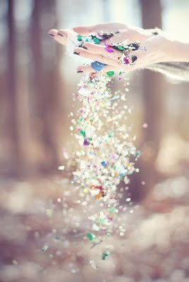
Microcosmos naturae, sedes hominum, theatrum historiae, eutopia futuris
The Microcosum of Nature, The Home of Man, The Theatre of History, The Good Place of the Future, Patrick Geddes

